Slide 1
Journey ppt
Sai Gowtham Tammineni

Slide 2
Day-1
THE .NET FRAMEWORK
Common language runtime (CLR)
CLR is an Execution Engine.
source code(c++/c# any .net languages) – compiler – assembly(DLL of EXE).
Jit Compiler – refers the IL complies it into Native code.
CL refers the Metadata and created a layout of memory to run the program.
Base Class Library
Set of classes.
Common repository of classes that every .net language refer to.
ASP.NET: Web services and web forms, windows Forms
Common Language Specification
VB C++ C# Jscript

Slide 3
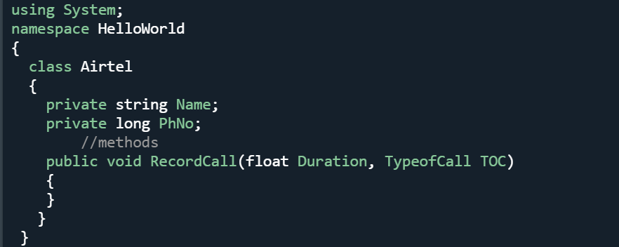
Day 2
microsoft uses Pascel casing
System>>NameSpace>>Class>>fields,properties,methods.
Properties are special type of methods that help to set and get fields.
Index is a property that can be associated with more than one field of same data type.
Enum are fixed quantities that are defined in namespace scope.
Abstract Class are the classes that cannot be instantized but can be inherited.
Collection is a container in which objects of different data types can be stored.
Generic container stores objects of different datatypes in which objects of same datatype are grouped. This gives a performance boost.

Slide 4

The way to get started is to quit talking and begin doing.
Walt Disney

Slide 5
Team
Name Title
Name Title
Name Title
Name Title

Slide 6
Day 3
Interfaces
Similar to abstract class but it is only declared, only has properties and methods.
Class which inherits interface should provide implementation for the everything that is declared in Interface.
Interfaces esposes the methodes and properties exposed only in it through class
Abstarct class Interface
Default AS=private default AS =public
Can be inherited from only one class can be inherited from multiple inheritances

Slide 7
Title
Subtitle
Subtitle
Subtitle
Add text, images, art, and videos.
Add transitions, animations, and motion.
Save to OneDrive, to get to your presentations from your computer, tablet, or phone.
Open the Design Ideas pane for instant slide makeovers.
When we have design ideas, we’ll show them to you right there.
This PowerPoint theme uses its own unique set of colors, fonts, and effects to create the overall look and feel of these slides.
PowerPoint has tons of themes to give your presentation just the right personality.

Slide 8



Summary
With PowerPoint, you can create presentations and share your work with others, wherever they are. Type the text you want here to get started. You can also add images, art, and videos on this template. Save to OneDrive and access your presentations from your computer, tablet, or phone.

Slide 9




Thank you
Presenter name
Email address
Website

